Slide 1


Use Season Stats to Predict NBA Players Salary
Group members:
Adela Yang,
Jack Lo,
Yuka Chen

Slide 2
Statement of the Problem
NBA players are on average the highest-paid athletes in the world, according to Statista.com.
Oftentimes sports players would seem to have major contracts with high annual salaries (some people would even think they should not get paid so much).
We want to find out whether the NBA players and their season total performance have a strong correlation.

Slide 3
Purpose
Discover
Discover which predictors variables are critical to the salaries of the NBA players
Regression
Use a multiple regression model to predict NBA players’ salaries
Examine
Examine the difference between the predicted salaries and actual salaries

Slide 4
Data Section
Data source
Our season total performance and salary data sets were collected from Basketball Reference (https://www.basketball-reference.com/)
Data set
Combined NBA player performance and salary data by using player ID and team. During the regular season, some of the players will change their team, so they have two different performance and salaries.

Slide 5
Processing the Data(Data Cleaning)
Combined three datasets (NBA player salaries summary 1985-2018, season performance for both 2016-2017 and 2017-2018)
Joined the data sets based on the player ID and their team names.
Removed 20 variables that seem to be either duplicated or are a combination of other variables. (i.e. trb = orb + drb).
Dropped the person who has the total performances as they transferred the teams during the season in order to focus on their performance.

Slide 6
Model Building Process
The response variable is salary.
The predictor variables include 2 categorical variables and 12 continuous variables.
fg%, 3p, 3p%, 2p, 2p%, ft%, trb, ast, stl, blk, tov, pts are our continuous variables.
pos and trans_team are categorical variables.

Slide 7
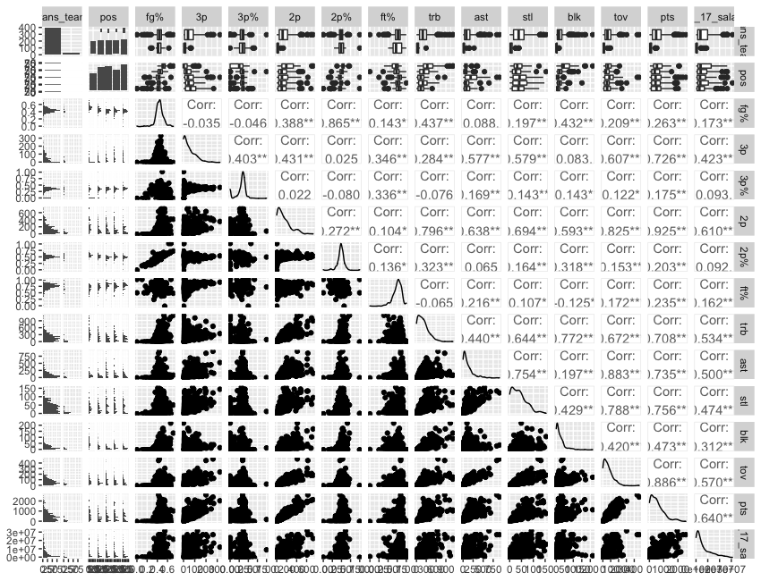
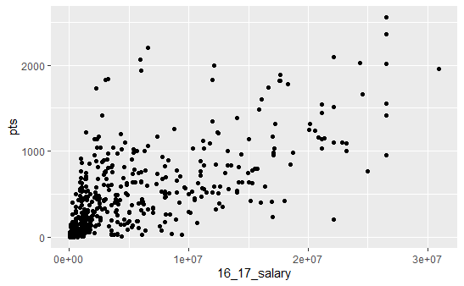
Correlation Analysis
Notes:
Based on the correlation plot, we can see the strongest linear relationship occurs between salary and points, although there could be a bit of a curvilinear relationship. 3p, 2p, trb, ast, stl, and tov have strong relationships as well.

Slide 8
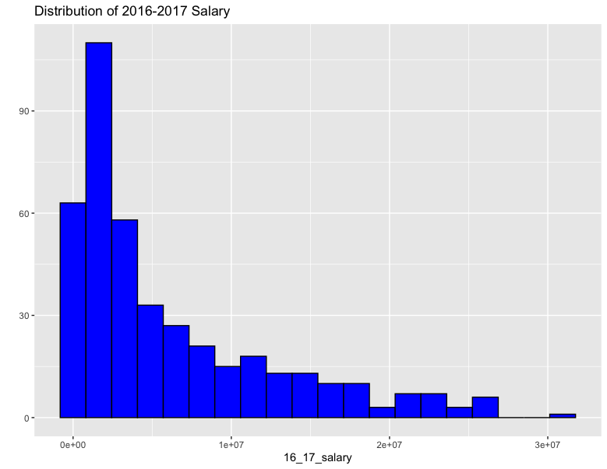
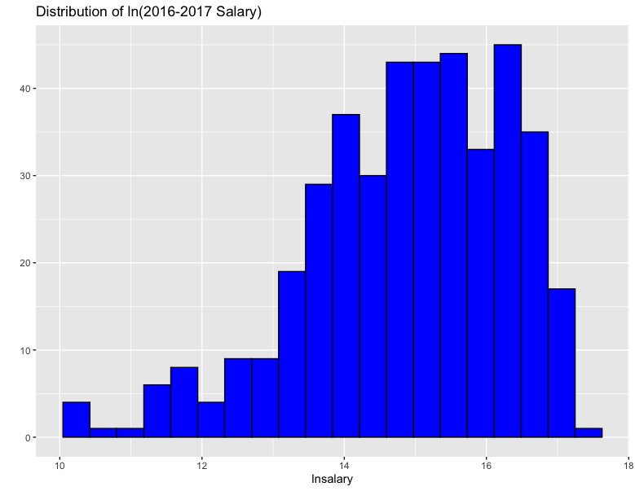
Checking Y Predictable
According to the histogram plot, we can see that the plot is right-skewed. To remedy the issue, we transformed the salary by taking log.
We see possibly a very slight left skew, but it is closer to symmetric than without transform salary.

Slide 9


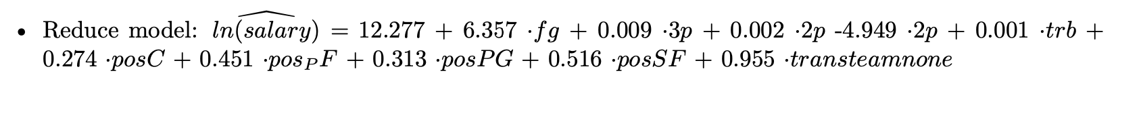
Introduce Three Comparing Model
Original Model(only continuous variables)
2. Reduce Model Based on All Subset Models Methods
3. Adding 5 Dummy Variables

Slide 10
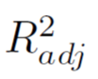
Comparing Model
For the full model without dummy variables (12 variables)
= 0.4096448
For the reduced model (5 variables) = 0.4095163
For the reduce model including dummy variables (10 variables)
= 0.4455106
Notes:
In terms of R square the reduce model including dummy variables does a better job fitting the data as it has the higher R square.

Slide 11
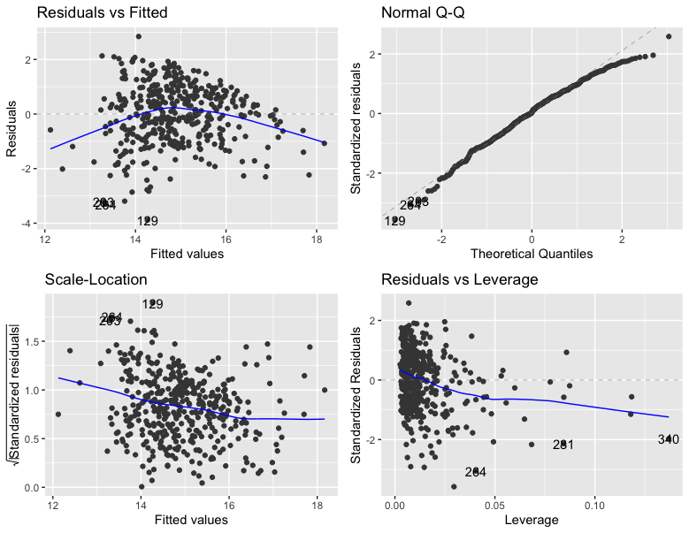
Model Testing
Based on the fitted residual plot, it seems some multi-linear regression assumptions are violated.

Slide 12
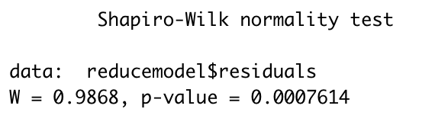
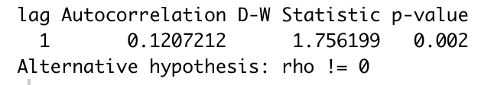
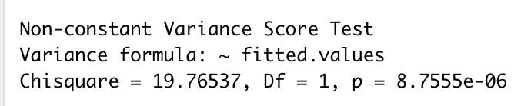
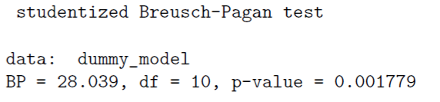
Model Testing(2)
Residual Normality Test
Residual Independence Test
Residual Variance Homogeneity Test
Testing for Non-Constant Variance Residual by Using Breusch-Pagan
Heteroskedascity
Notes:
Residual Normality Test
According to the Shapiro-Wilk normality test with a test statistic of 0.99 and an associated p-value = 0.00187, since the p-value is below 0.05 which indicates the NBA Dummy data significantly deviate from a normal distribution.
Residual Independence Test
According to the Durbin-Watson test with a test statistic of 1.81 and an associated p-value = 0.024, since the test statistic fell into the range of 0 to 2, which indicates that that there is a positive autocorrelation.
Residual Variance Homogeneity Test
According to the non-constant variance score test with a chisquare 16.5513 and an associated p-value = 0.000047, which indicates that there has a heteroskedasticity issue.
Testing for Non-Constant Variance Residual by Using Breusch-Pagan
According to the Breusch-Pagan Test with a test statistic = 28.039 and an associated p-value = 0.0018, under the assumption that H0 is true (variance of the disturbance terms is constant), it would be quite unlikely that we would observe a test statistic of our magnitude or larger.
Consequently, we can reject H0 and conclude there is a sufficient statistical evidence to indicate that the variance is changing relative to the magnitude of lnsalary, which means we need to take further procedure to fix the issues.
As the results from several model testing, we can confirm there is some heteroskedascity issues with our residual and fitted value, as well as the residual normality.

Slide 13

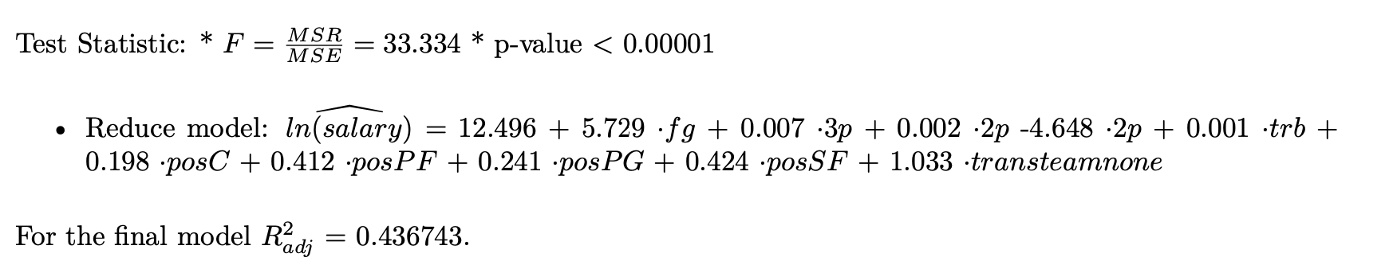
Fixing Heteroskedasticity by Using WLS
Since the residual plot show that the error look like uneven distribution, it violates the assumption of homogeneity of variance. As the result, it has heterodasticity issue, so we solve this violation by using WLS.
Final Model

Slide 14
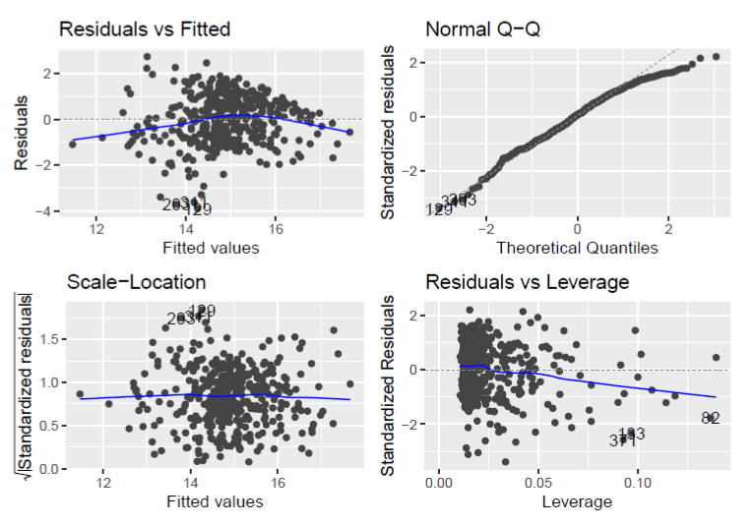
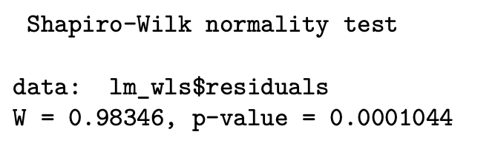
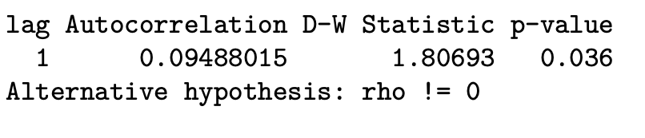
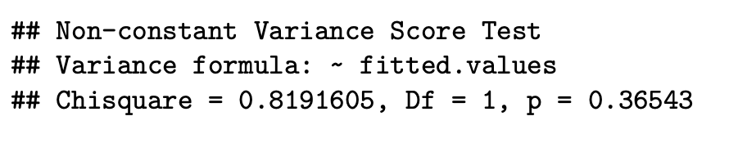
Assumptions
The model has followed all assumptions, except residual normality test.
Residual Normality Test
Residual Independence Test
Residual Variance Homogeneity Test

Slide 15
Evaluate Forecast Model
We use a forecasting model to determine how well it does in producing accurate forecasts, not how well it fits the historical model.
Measuring forecast accuracy, MAD=0.864, MSE=1.124.
From the result, both MAD and MSE are small and close to 0, actual values are very close to the predicted values.
It means that the prediction model we done is working well.

Slide 16

Inferences Based on the Model
After we build the multiple regression model, we can predict NBA players’ salaries. The model has followed all assumptions except residual normality test.
Furthermore, the difference between predicted and actual salaries is small(MAD=0.864, MSE=1.124), which means that our model is great for applying.

Slide 17
Future Directions
Since the data only offer the data that indicate players trans team during the regular season, isn’t include off the season data that most of the players trans team time. For the further study, we recommend that add the resign the contrast or not, because the longer time interval model contrast effect maybe improve the results.
The coefficient of 2p% is -4.949. (weird)
We would like to collect
1)seniority
2)the points per game to help improve your results.
We only use 16-17 salary to build our model, if we can add different year of salary data in our model, we could consider to use panel data analysis in our future research.

Slide 18
Group Work
Project Concept Contribution: Jack
Data collection: Adela
Data cleaning: Yuka
Model Building Process: Yuka, Adela
Analysis result: Yuka, Adela, Jack
PPT: Jack

